Slide 1

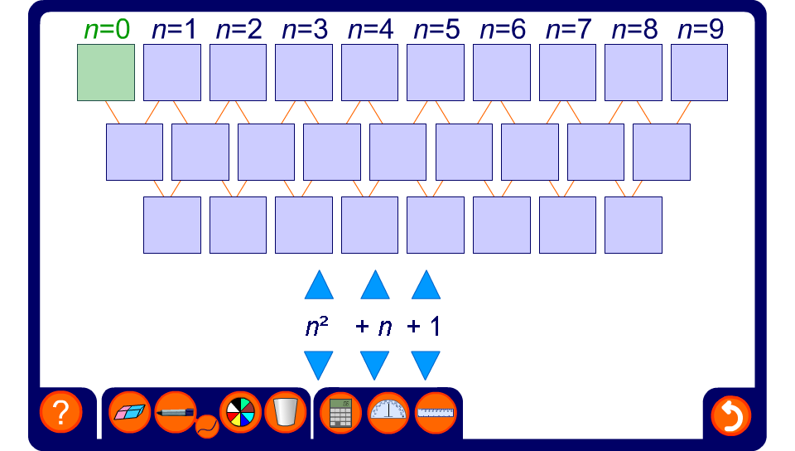


Investigating quadratic sequences
Notes:
Use this activity to practice substituting position numbers into the general form of a quadratic sequence.
Investigate the connection between the constant term in the second row of differences and the coefficient of n² in the general term. Establish that the second difference will always be equal to 2a, where a is the coefficient of n².
Investigate the connection between the value of the 0th term and the value of c in the general form an² + bn + c.

